Slide 1



Class Inheritance
Introduction to Computer Science
Reichman University
Lecture 11-2

Slide 2
Inheritance
Background
Inheritance is a major feature of object-oriented programming
We’ll give an introduction to inheritance, focusing on main concepts and techniques.
Two forms of inheritance
Class inheritance (this lecture)
Interface inheritance (next lecture)

Slide 3
Inheritance
Requirement (example): Develop a system that manages instructors, students, and courses.
Observation
Instructors and students have common properties: name, address, birth date, ...
and common operations: getAddress, setAddress, ...
Insight: Create...
a “super-class” that represents the common properties (fields) and operations (methods), and
“sub-classes” that add instructor-specific and student-specific properties and operations.
Person
super-class / parent class
is-a
is-a
sub-class /
child class
Instructor
Student
is-a
is-a
Objects:
Socrates
Feynman
...
Confucius
Ron
...
Neta
Avigail

Slide 4
Super-class: Person
/** Represents a person. */
public class Person {
// Person fields
protected String name;
protected String address;
/** Constructs a Person */
public Person(String name, String address) {
this.name = name;
this.address = address;
}
/** Sets the address of this person. */
public void setAddress(String address) {
this.address = address;
}
/** Textual description of this person. */
public String toString() {
name + ", " + address;
}
// More Person methods...
}
Represents the common properties and operations that every person in the university has.
Member (field / method) visibility:
private: visible only in this class
protected: also visible by sub-classes
public: visible by any class
No modifier: package-private (later)

Slide 5
Sub-class: Instructor
/** Represents a person. */
public class Person {
// Person fields
protected String name;
protected String address;
/** Constructs a Person */
public Person(String name, String address) {
this.name = name;
this.address = address;
}
/** Sets the address of this person. */
public void setAddress(String address) {
this.address = address;
}
/** Textual description of this person. */
public String toString() {
name + ", " + address;
}
// More Person methods...
}
/** Represents an instructor. */
public class Instructor extends Person { // Instructor-specific fields:
private String title;
/** Constructs an instructor. */
public Instructor(String name, String address,
String title) {
super(name, address)
this.title = title;
}
/** Textual description of this instructor. */
@Override
public String toString() {
return title + " " + super.toString();
}
// More Instructor methods...
}
super-class
sub-class
extends Person
Inherits all the Person members (fields + methods)
Plus, adds instructor-specific properties and operations.

Slide 6
Sub-class: Instructor
/** Represents a person. */
public class Person {
// Person fields
protected String name;
protected String address;
/** Constructs a Person */
public Person(String name, String address) {
this.name = name;
this.address = address;
}
/** Sets the address of this person. */
public void setAddress(String address) {
this.address = address;
}
/** Textual description of this person. */
public String toString() {
name + ", " + address;
}
// More Person methods...
}
/** Represents an instructor. */
public class Instructor extends Person { // Instructor-specific fields:
private String title;
/** Constructs an instructor. */
public Instructor(String name, String address,
String title) {
super(name, address)
this.title = title;
}
/** Textual description of this instructor. */
@Override
public String toString() {
return title + " " + super.toString();
}
// More Instructor methods...
}
super-class
sub-class
Typical sub-class constructor:
Starts by calling the super-class constructor to create the object and handle the super-class fields. Then handles the sub-class fields.
Unlike other class members, constructors are not inherited;
A sub-class constructor must begin by calling a super constructor.

Slide 7
Sub-class: Instructor
/** Represents a person. */
public class Person {
// Person fields
protected String name;
protected String address;
/** Constructs a Person */
public Person(String name, String address) {
this.name = name;
this.address = address;
}
/** Sets the address of this person. */
public void setAddress(String address) {
this.address = address;
}
/** Textual description of this person. */
public String toString() {
name + ", " + address;
}
...
}
/** Represents an instructor. */
public class Instructor extends Person { // Instructor-specific fields:
private String title;
/** Constructs an instructor. */
public Instructor(String name, String address,
String title) {
super(name, address)
this.title = title;
}
/** Textual description of this instructor. */
@Override
public String toString() {
return title + " " + super.toString();
}
// More Instructor methods...
}
super-class
sub-class
Typical toString
Displays the fields of the sub-class, and calls the toString of the super-class to display its fields.

Slide 8
Sub-class: Instructor
/** Represents a person. */
public class Person {
// Person fields
protected String name;
protected String address;
/** Constructs a Person */
public Person(String name, String address) {
this.name = name;
this.address = address;
}
/** Sets the address of this person. */
public void setAddress(String address) {
this.address = address;
}
/** Textual description of this person. */
public String toString() {
name + ", " + address;
}
...
}
/** Represents an instructor. */
public class Instructor extends Person { // Instructor-specific fields:
private String title;
/** Constructs an instructor. */
public Instructor(String name, String address,
String title) {
super(name, address)
this.title = title;
}
/** Textual description of this instructor. */
@Override
public String toString() {
return title + " " + super.toString();
}
// More Instructor methods...
}
super-class
sub-class
Alternative toString implementation:
/** Textual description of this instructor. */
@Override
public String toString() {
return title + " " + name + " " + address;
}
Can you explain why it will work?

Slide 9
Overrides
/** Represents a person. */
public class Person {
// Person fields
protected String name;
protected String address;
/** Constructs a Person */
public Person(String name, String address) {
this.name = name;
this.address = address;
}
/** Sets the address of this person. */
public void setAddress(String address) {
this.address = address;
}
/** Textual description of this person. */
public String toString() {
name + ", " + address;
}
...
}
/** Represents an instructor. */
public class Instructor extends Person { // Instructor-specific fields:
private String title;
/** Constructs an instructor. */
public Instructor(String name, String address,
String title) {
super(name, address)
this.title = title;
}
/** Textual description of this instructor. */
@Override
public String toString() {
return title + " " + super.toString();
}
// More Instructor methods...
}
super-class
sub-class
overrides
A sub-class can override any super-class method;
(Not to be confused with overloading).

Slide 10
Inheritance in action
/** Represents a person. */
public class Person {
// Person fields
protected String name;
protected String address;
/** Constructs a Person */
public Person(String name, String address) {
this.name = name;
this.address = address;
}
/** Sets the address of this person. */
public void setAddress(String address) {
this.address = address;
}
/** Textual description of this person. */
public String toString() {
name + ", " + address;
}
...
}
/** Represents an instructor. */
public class Instructor extends Person { // Instructor-specific fields:
private String title;
/** Constructs an instructor. */
public Instructor(String name, String address,
String title) {
super(name, address)
this.title = title;
}
/** Textual description of this instructor. */
@Override
public String toString() {
return title + " " + super.toString();
}
...
}
super-class
sub-class
client code
Instructor soc =
new Instructor("Socrates", "Athens", "Prof.");
Instructor dick = new Instructor("Feynman", "LA", "Dr.");
soc.setAddress("Tel Aviv"); // changing soc’s address
System.out.println(soc);
System.out.println(dick);
output
Prof. Socrates, Tel Aviv
Dr. Feynman, LA

Slide 11
Inheritance in action
/** Represents a person. */
public class Person {
// Person fields
protected String name;
protected String address;
/** Constructs a Person */
public Person(String name, String address) {
this.name = name;
this.address = address;
}
/** Sets the address of this person. */
public void setAddress(String address) {
this.address = address;
}
/** Textual description of this person. */
public String toString() {
name + ", " + address;
}
...
}
/** Represents an instructor. */
public class Instructor extends Person { // Instructor-specific fields:
private String title;
/** Constructs an instructor. */
public Instructor(String name, String address,
String title) {
super(name, address)
this.title = title;
}
/** Textual description of this instructor. */
@Override
public String toString() {
return title + " " + super.toString();
}
...
}
super-class
sub-class
client code
Instructor soc =
new Instructor("Socrates", "Athens", "Prof.");
Instructor dick = new Instructor("Feynman", "LA", "Dr.");
soc.setAddress("Tel Aviv"); // changing soc’s address
System.out.println(soc);
System.out.println(dick);
Calling a super-class (super type) method
soc is an Instructor;
But soc is also a Person;
That’s why we can call a Person method on an Instructor object.
output
Prof. Socrates, Tel Aviv
Dr. Feynman, LA

Slide 12
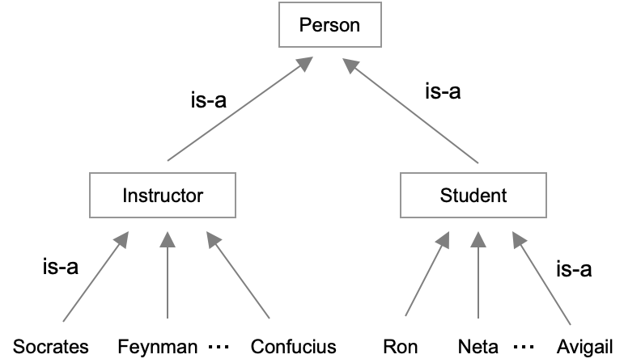
Sub-class: Student
/** Represents a student. */
public class Student extends Person {
// Instructor-specific fields:
private int studentId;
private String club;
/** Constructs a student. */
public Student(String name, String address,
int studentId, String club) {
super(name, address);
this.studentId = studentId;
this.club = club;
}
/** Textual description of this student. */
@Override
public String toString() {
return super.toString() + ", id: " +
studentId + ", club: " + club;
}
...
}
Like any other sub-class:
Inherits all the super-class members;
Typically adds some members of its own;
Typically overrides some super-class method.
sub-class
Possible extensions (examples)
List of courses, and grades
GPA
...

Slide 13
Abstract class / abstract method
/** Represents a person. */
public abstract class Person {
// Person fields
protected String name;
protected String address;
/** Constructs a Person */
public Person(String name, String address) {
this.name = name;
this.address = address;
}
/** Sets the address of this person. */
public void setAddress(String address) {
this.address = address;
}
/** Gets the role of this person. */
// To be implemented by sub-classes.
public abstract String getRole();
/** Textual description of this person. */
public String toString() {
return getRole() + " " + name + ", " + address;
}
...
}
Sometimes we want to force each sub-class to have some feature of its own.
Example: We want each instructor and student to have a role in the university.
Abstract method
A placeholder method, must be implemented by every sub-class of this class.
Technical point: If a class contains one or more abstract methods, it becomes an abstract class

Slide 14
Abstract class / abstract method
/** Represents a person. */
public abstract class Person {
// Person fields
protected String name;
protected String address;
/** Constructs a Person */
public Person(String name, String address) {
this.name = name;
this.address = address;
}
/** Sets the address of this person. */
public void setAddress(String address) {
this.address = address;
}
/** Gets the role of this person. */
// To be implemented by sub-classes.
public abstract String getRole();
/** Textual description of this person. */
public String toString() {
return getRole() + " " + name + ", " + address;
}
...
}
/** Represents an instructor. */
public class Instructor extends Person { // Instructor-specific fields:
private String title;
/** Constructs an instructor. */
public Instructor(String name, String address,
String title) {
super(name, address)
this.title = title;
}
/** Gets the role of this instructor. */
@Override
public String getRole() {
return "Instructor " + title;
}
/** Textual description of this instructor. */
@Override
public String toString() {
return super.toString();
}
}
super-class
sub-class
must
A sub-class must override every super-class abstract method;
A sub-class can override any other super-class method.

Slide 15
Abstract class / abstract method
/** Represents a person. */
public abstract class Person {
// Person fields
protected String name;
protected String address;
/** Constructs a Person */
public Person(String name, String address) {
this.name = name;
this.address = address;
}
/** Sets the address of this person. */
public void setAddress(String address) {
this.address = address;
}
/** Gets the role of this person. */
// To be implemented by sub-classes.
public abstract String getRole();
/** Textual description of this person. */
public String toString() {
return getRole() + " " + name + ", " + address;
}
...
}
/** Represents a student. */
public class Student extends Person {
// Instructor-specific fields:
private int studentId;
private String club;
/** Constructs a student. */
public Student(String name, String address,
int studentId, String club) {
super(name, address);
this.studentId = studentId;
this.club = club;
}
/** Gets the role of this students. */
@Override
public String getRole() {
return "Student";
}
/** Textual description of this student. */
@Override
public String toString() {
return super.toString() + ", id: " +
studentId + ", club: " + club;
}
...
}
super-class
sub-class
must
A sub-class must override every super-class abstract method;
A sub-class can override any super-class method.

Slide 16
Inheritance in action
// Creates some persons
Person[] persons = new Person[] {
new Instructor("Socrates", "Raanana", "Prof."),
new Instructor("Feynman", "Tel Aviv", "Dr."),
new Student("Ron", "Raanana", 1001, "Dance"),
new Student("Neta", "Raanana", 1002, "Debate"),
new Student("Avigail", "Tel Aviv", 1003, "Dance")
};
// Prints all persons
for (Person person : persons) {
System.out.println(person);
}
client code
Polymorphism
Iterating over super-type objects, letting each object take care of itself (according to its sub-type).
Instructor Prof. Socrates, Raanana
Instructor Dr. Feynman, Tel Aviv
Student Ron, Raanana, id: 1001, club: Dance
Student Neta, Raanana, id: 1002, club: Debate
Student Avigail, Tel Aviv, id: 1003, club: Dance

Slide 17
Inheritance in action
// Creates some persons
Person[] persons = new Person[] {
new Instructor("Socrates", "Raanana", "Prof."),
new Instructor("Feynman", "Tel Aviv", "Dr."),
new Student("Ron", "Raanana", 1001, "Dance"),
new Student("Neta", "Raanana", 1002, "Debate"),
new Student("Avigail", "Tel Aviv", 1003, "Dance")
};
// Prints all persons
for (Person person : persons) {
System.out.println(person);
}
// Prints all persons from Raanana
printPersonsFromCity(persons, "Raanana");
// Prints all the persons from the given city.
public static void printPersonsFromCity(Person[] persons, String city) {
for (Person person : persons) {
if (person.address.equals(city)) {
System.out.println(person);
}
}
}
client code
Polymorphism
Iterating over super-type objects, letting each object take care of itself (according to its sub-type).
Instructor Prof. Socrates, Raanana
Instructor Dr. Feynman, Tel Aviv
Student Ron, Raanana, id: 1001, club: Dance
Student Neta, Raanana, id: 1002, club: Debate
Student Avigail, Tel Aviv, id: 1003, club: Dance
Instructor Prof. Socrates, Raanana
Student Ron, Raanana, id: 1001, club: Dance
Student Neta, Raanana, id: 1002, club: Debate

Slide 18
Lecture plan
Inheritance / sub-classing
Inheritance vs composition
The class Object
Important Object methods

Slide 19
Lecture plan
Inheritance / sub-classing
Inheritance vs composition
The class Object
Important Object methods

Slide 20
Inheritance example: Colored Points
/** Represents a point. */
public class Point {
// The coordinates of this point
protected int x, y;
/** Constructs a point. */
public Point(int x, int y) {
this.x = x;
this.y = y;
}
/** Textual representation */
public String toString() {
return "(" + x + "," + y + ")";
}
...
}
import java.awt.Color;
/** Represents a colored point. */
public class ColoredPoint extends Point {
// The color of this point.
private Color color;
/** Constructs a colored point. */
public ColoredPoint(int x, int y, Color color) {
super(x,y); // calls a super constructor
this.color = color;
}
/** Constructs a point, colored black */
public ColoredPoint(int x, int y) {
this(x, y, Color.black);
}
/** Textual representation of this point. */
public String toString() {
return super.toString() + " " + color;
}
...
}
super-class
sub-class
Client code:
// Creates and prints colored points:
ColoredPoint cp1 = new ColoredPoint(3,2,Color.red);
System.out.println(cp1);
ColoredPoint cp2 = new ColoredPoint(5,7);
System.out.println(cp2);
// Output:
(3,2) [r=255,g=0,b=0]
(5,7) [r=0,g=0,b=0]
return values of the toString() method of Color

Slide 21
Inheritance example: Colored Points
/** Represents a point. */
public class Point {
// The coordinates of this point
protected int x, y;
/** Constructs a point. */
public Point(int x, int y) {
this.x = x;
this.y = y;
}
/** Textual representation */
public String toString() {
return "(" + x + "," + y + ")";
}
...
}
Sub-classing
Same code as previous slide
super-class
import java.awt.Color;
/** Represents a colored point. */
public class ColoredPoint extends Point {
// The color of this point.
private Color color;
/** Constructs a colored point. */
public ColoredPoint(int x, int y, Color color) {
super(x,y); // calls a super constructor
this.color = color;
}
...
}
Composing
A regular class that has an object as one of its fields (no inheritance)
ColoredPoint objects are composed from Point objects
import java.awt.Color;
/** Represents a colored point. */
public class ColoredPoint {
private Point point
private Color color;
/** Constructs a colored point. */
public ColoredPoint(int x, int y, Color color) {
this.point = new Point(x,y);
this.color = color;
}
/** Textual representation of this point. */
public String toString() {
return point + " " + color;
}
...
}
Best practice
Inheritance has advantages, but results in complex systems;
When possible, favor composition over inheritance.
(KISS)

Slide 22
Lecture plan
Inheritance / sub-classing
Inheritance vs composition
The class Object
Important Object methods

Slide 23
The class / type hierarchy
Object: the super-class of all Java classes
Object
is-a
Person
Point
is-a
Instructor
Student
ColoredPoint
Objects:
socrates
feyenman
neta
cp1
cp2
cp3
Every class in Java is a sub-class of the Object class;
Therefore, every Java object inherits all the Object methods;
Following this convention, Java’s designers made the Object class declare a few default methods that they wanted every object to have.

Slide 24
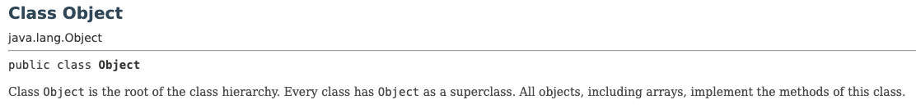
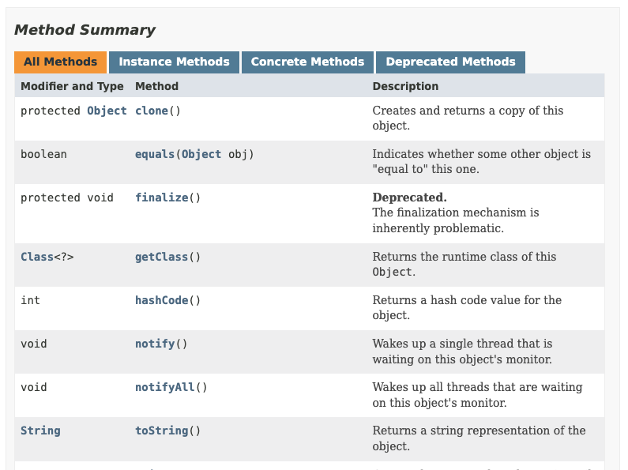
Object methods

Slide 25
Object methods
toString(): // Returns a textual representation of this object
equals(Object obj): // Compares this object to another object
hashCode(): // Provides a unique ID for this object

Slide 26
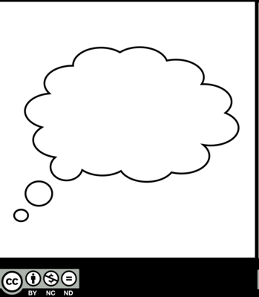

Object methods: toString
super class of all objects
example of a class that has no toString method
/** Represents every object in every class. */
public class Object {
...
/** Returns the class of this object. */
public Class getClass() { ... }
/** Returns the hash code value of this object. */
public int hashCode() { ... }
...
/** Default toString implementation */
public String toString() {
return getClass().getName() + "@" +
Integer.toHexString(hashCode());
}
// More Object methods
}
/** Represents a point. */
public class Point {
// The coordinates of this point
private int x, y;
/** Constructs a point. */
public Point(int x, int y) {
this.x = x;
this.y = y;
}
// This Point class has no toString method.
...
}
// Client code, in some class:
Point p1 = new Point(2,3);
Point p2 = new Point(2,3);
System.out.println(p1);
System.out.println(p2);
Java calls the first toString() method up the class hierarchy. In this case, it’s the toString of Object
// Output
Point@8fd9b4d
Point@f7b650a
Huh?

Slide 27
Object methods: toString
super class of all objects
example of a class that has no toString method
/** Represents every object in every class. */
public class Object {
...
/** Returns the class of this object. */
public Class getClass() { ... }
/** Returns the hash code value of this object. */
public int hashCode() { ... }
...
/** Default toString implementation */
public String toString() {
return getClass().getName() + "@" +
Integer.toHexString(hashCode());
}
// More Object methods
}
/** Represents a point. */
public class Point {
// The coordinates of this point
private int x, y;
/** Constructs a point. */
public Point(int x, int y) {
this.x = x;
this.y = y;
}
// This Point class has no toString method.
...
}
// Client code, in some class:
Point p1 = new Point(2,3);
Point p2 = new Point(2,3);
System.out.println(p1);
System.out.println(p2);
getClass (an Object method) returns the class to which this object belongs; The class is returned as a Class object;
getName (a Class method) returns the class name;
hashCode (an Object method) returns the unique object ID.
// Output
Point@8fd9b4d
Point@f7b650a

Slide 28
Object methods: toString
super class of all objects
/** Represents a point. */
public class Point {
// The coordinates of this point
private int x, y;
/** Constructs a point. */
public Point(int x, int y) {
this.x = x;
this.y = y;
}
/** A textual representation of this point. */
public String toString() {
return "(" + x + "," + y + ")";
}
...
}
/** Represents every object in every class. */
public class Object {
...
/** Returns the class of this object. */
public Class getClass() { ... }
/** Returns the hash code value of this object. */
public int hashCode() { ... }
...
/** Default toString implementation */
public String toString() {
return getClass().getName() + "@" +
Integer.toHexString(hashCode());
}
// More Object methods
}
// Client code, in some class:
Point p1 = new Point(2,3);
Point p2 = new Point(2,3);
System.out.println(p1);
System.out.println(p2);
Best practice:
Always write a toString() method, to override the default implementation.
// Output
(2,3)
(2,3)
The result: A sensible way to display Point objects.

Slide 29
Object methods
toString(): // Returns a textual representation of this object
equals(Object obj): // Compares this object to another object
hashCode(): // Provides a unique ID for this object

Slide 30
Object methods: equals
super class of all objects
example of a class that has no equals method
/** Represents every object in every class. */
public class Object {
...
/** Returns the class of this object. */
public Class getClass() { ... }
/** Returns the hash code value of this object. */
public int hashCode() { ... }
...
/** Returns a textual representation of this object */
public String toString() {
return getClass().getName() + "@" +
Integer.toHexString(hashCode());
}
/** Default “equals to” implementation. */
public boolean equals(Object other) {
return (this == other);
}
// More Object methods
}
/** Represents a point. */
public class Point {
// The coordinates of this point
private int x, y;
/** Constructs a point. */
public Point(int x, int y) {
this.x = x;
this.y = y;
}
// This Point class has no equals method.
...
}
// Client code (in any class):
Point p1 = new Point(2,3);
Point p2 = new Point(2,3);
System.out.println(p1.equals(p2)); // false
Result: Objects that are semantically equal are considered unequal.
The equals() method of the Object class performs the most basic equality check, ignoring the object’s semantics.

Slide 31
Object methods: equals
super class of all objects
/** Represents every object in every class. */
public class Object {
...
/** Returns the class of this object. */
public Class getClass() { ... }
/** Returns the hash code value of this object. */
public int hashCode() { ... }
...
/** Returns a textual representation of this object */
public String toString() {
return getClass().getName() + "@" +
Integer.toHexString(hashCode());
}
/** Default “equals to” implementation. */
public boolean equals(Object other) {
return (this == other);
}
// More Object methods
}
/** Represents a point. */
public class Point {
// The coordinates of this point
private int x, y;
/** Constructs a point. */
public Point(int x, int y) {
this.x = x;
this.y = y;
}
/** Checks if this point equals to the other point. */
public boolean equals(Point other) {
return ((x == other.x) && (y == other.y));
}
...
}
// Client code (in any class):
Point p1 = new Point(2,3);
Point p2 = new Point(2,3);
System.out.println(p1.equals(p2)); // true
Best practice:
Always write an equals method, to override the default implementation.
Result: A semantically sensible way to check if two objects are equal.

Slide 32
Equals (industrial-strength version...)
super class of all objects
/** Represents every object in every class. */
public class Object {
...
/** Returns the class of this object. */
public Class getClass() { ... }
/** Returns the hash code value of this object. */
public int hashCode() { ... }
...
/** Returns a textual representation of this object */
public String toString() {
return getClass().getName() + "@" +
Integer.toHexString(hashCode());
}
/** Default “equals to” implementation. */
public boolean equals(Object other) {
return (this == other);
}
// More Object methods
}
/** Represents a point. */
public class Point {
// The coordinates of this point
private int x, y;
...
/** Checks if this point equals to the other point.
@Override
public boolean equals(Object other) {
// A complete, bullet-proof implementation of “equals” :
if (other == null) return false;
if (this == other) return true;
// Note: In Java, during runtime, objects are allowed to
// change their types (discussed later...). Therefore, when
// clients call obj1.equals(obj2), we must check
// that the two objects have the same type:
if (getClass() != other.getClass()) return false;
// Now we know that other is a Point object,
// but the compiler doesn’t know it. So, we cast it:
Point other = (Point) other;
// And only now we can safely check all the fields:
if (x != other.x) return false;
if (y != other.y) return false;
return true;
// Sigh!
}
// More Point methods
}
The @Override tag: tells the compiler to verify that the signature of this method is identical to the signature of the super method.
Best practice: Use this tag when overriding a method.

Slide 33
Object methods
toString(): // Returns a textual representation of this object
equals(Object obj): // Compares this object to another object
hashCode(): // Provides a unique ID for this object

Slide 34
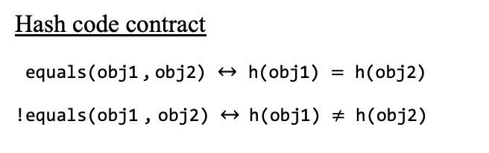
Object methods: hashCode
super class of all objects
example of a class that has no hashCode method
/** Represents every Object. */
public class Object {
...
/** Checks if this object “equals to” the other object. */
public boolean equals(Object other) {
return (this == other);
}
/** Default hashCode implementation. */
public int hashCode() {
// Objects that are physically different get
// different hash codes. Code omitted.
}
// More Object methods
}
/** Represents a point. */
public class Point {
// The coordinates of this point
private int x, y;
...
/** Checks if this point equals to the other point. */
public boolean equals(Point other) {
return ((x == other.x) && (y == other.y));
}
// This Point class has no hashCode method.
...
}
// Client code, in some class:
Point p1 = new Point(2,3);
Point p2 = new Point(2,3);
Point p3 = new Point(1,2);
System.out.println(p1.hashCode()); // 150838093
System.out.println(p2.hashCode()); // 259745034
System.out.println(p3.hashCode()); // 205146899
Hash code contract
equals(obj1 , obj2) $↔$ h(obj1) $=$ h(obj2)
!equals(obj1 , obj2) $↔$ h(obj1) $≠$ h(obj2)
the contract is broken

Slide 35
Object methods: hashCode
super class of all objects
/** Represents every Object. */
public class Object {
...
/** Checks if this object “equals to” the other object. */
public boolean equals(Object other) {
return (this == other);
}
/** Default hashCode implementation. */
public int hashCode() {
// Objects that are physically different get
// different hash codes. Code omitted.
}
// More Object methods
}
/** Represents a point. */
public class Point {
// The coordinates of this point
private int x, y;
...
/** Checks if this point equals to the other point. */
public boolean equals(Point other) {
return ((x == other.x) && (y == other.y));
}
/** Returns the hash code of this point. */
public int hashCode() {
int prime = 31;
int result = 1;
result = prime * result + x;
result = prime * result + y;
return result;
}
...
}
Best practice:
Write a hashCode() method, to override the default implementation.
// Client code, in some class:
Point p1 = new Point(2,3);
Point p2 = new Point(2,3);
Point p3 = new Point(1,2);
System.out.println(p1.hashCode()); // 1026
System.out.println(p2.hashCode()); // 1026
System.out.println(p3.hashCode()); // 994
Hash code contract
equals(obj1 , obj2) $↔$ h(obj1) $=$ h(obj2)
!equals(obj1 , obj2) $↔$ h(obj1) $≠$ h(obj2)
The contract is maintained

Slide 36
Object methods
toString(): // Returns a textual representation of this object
equals(Object obj): // Compares this object to another object
hashCode(): // Provides a unique ID for this object
Best practice
When writing a class (for real...), always implement these 3 methods;
Why? These methods play important roles in many programming settings, and other classes (that you don’t control) assume that you’ve implemented them;
Good news: IDEs offer automatic / default creation of these methods.

Slide 37
Recap: Inheritance
Reasons to learn class inheritance
Many software systems are based on inheritance
The Java class library is based on inheritance (and so is its documentation)
You may have to develop / debug / extend systems that are based on inheritance
Observations
Class inheritance (this lecture) is powerful, but complex and error-prone
Interface inheritance (next lecture) is powerful, and simple.

Slide 38
Inheritance
Person
is-a
is-a
Instructor
Student
is-a
is-a
Objects:
Socrates
Feynman
...
Confucius
Ron
...
Neta
Avigail

